Slide 1
What we talk about when we talk about Observability Frameworks
Timothy Mahoney
Monitorama 2023

Slide 2
Who am I?
Timothy Mahoney
Senior Systems Engineer
Observability Pipeline Team
IKEA Retail
Notes:
Who am I? I am Timothy Mahoney, senior systems engineer in the Observability pipeline team.
My team is part of Operational Intelligence at IKEA Retail
I have been at IKEA for 2 years. I started out as a sysadmin in the 90s, spent most of the 2000s and 2010s working in satellite communication before moving on to log analytics and Splunk.
I am originally from Michigan but have been living in Sweden for the past 22 years. My wife and son and our dog are here in America visiting family this summer.

Slide 3


Trying to be clever with the title.
It works because we are next to a bookstore.
Notes:
The idea for this talk came to me during the creation of our Observability Framework.
The Framework itself wouldn't be so terribly interesting outside of IKEA due to Conway's Law, but the process and the discussions around it were really interesting.
The title came from a book I read on running marathons by Haruki Murakami called "What I talk about when I talk about running". In preparing this presentation, I learned that the title of Mr Murakami's book was an homage to Raymond Carver's book "what we talk about when we talk about love".
So this presentation could be what we talk about when we love observability and need to create an observability framework.

Slide 4
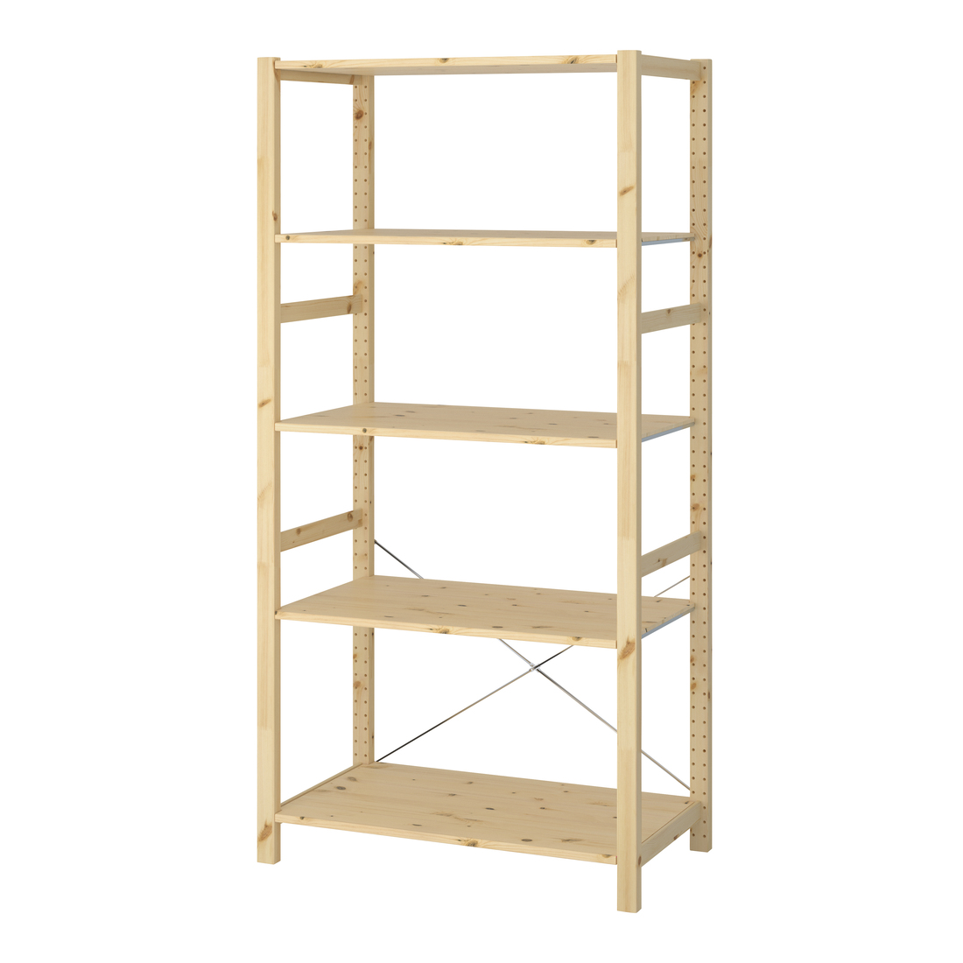
The Goal
An Observability Framework that:
Allows Developer Freedom
Reflects Company values
Encourages Adoption
Notes:
Provide a framework as guidance to the many engineers at Ikea that respects developer freedom, reflects our company values and encourages adoption.
As a team we were instructed to take on the task of moving our Observability ADRs from Draft to Accepted and encourage adoption of the framework.
The challenge would be we would lack the mandate to force adoption. I questioned this all the way up to the creation of this talk.

Slide 5
Contributors
Team Discussion
Observability Slack
Workshops
Forums
Conferences
Notes:
I am very fortunate to work in a team of talented and curious people who are passionate about observability.
As a team we have experience with programming, systems, monitoring, ops,
Within Operational Intelligence we have teams working with log analytics and application performance monitoring who actively contributed to our discussions on the architectural design records and our work on the framework. There are also have engineers from teams within IKEA Retail who keen to share their knowledge, experience and frustrations with us.
Beyond that we have such a wealth of information from events like Monitorama, people who openly share their observability experiences and opinions online.

Slide 6

The Detractors
The cult of the dumpster fire emoji.
Notes:
So we were given this opportunity to create an Observability Framework with the caveat that we must advocate for its adoption.
Being enthusiastically naïve, I was sure that the time and effort put into making it would be celebrated far and wide.
It didn't take long to discover that not everyone was as enthusiastic. Questions would turn up in slack channels and the answer would be a lone dumpster fire emoji.
Engineers are busy people and there isn't always the energy, time or empathy to engage in a discussion, but It made me frustrated and angry.
Even worse, the effect was contagious. I am willing to accept critism, but empty criticism isn't going to make a better framework.
Disclaimer: this is not indicative of IKEA work culture. It goes against our values and company culture.

Slide 7
Groundwork
Cognitive overload
Documentational debt
Technical debt
Notes:
Be constructively lazy
Nobody wants to read your 50 page document on logs or listen to you talk about tracing for 2 hours.
Don't produce more documentation than your team can manage to keep updated.

Slide 8
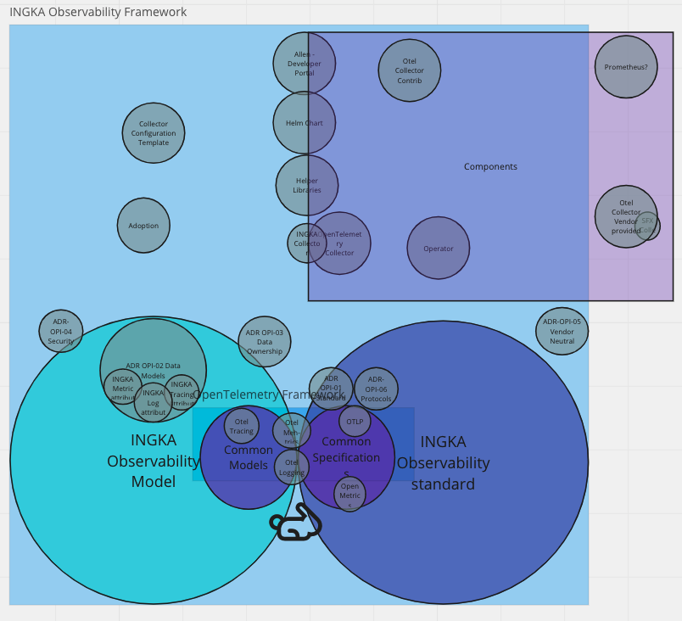
Do we even know what we are talking about?
Don't assume a common understanding of concepts.
Don't be afraid to ask trivial questions.
Notes:
So after the discovery of the cult of the dumpster fire emoji, my Imposter Syndrome started to tingle.
In internal discussions and discussions with other teams, I noticed people were reflexively using terms like framework and data model interchangably.
We had our ADRs and we had the components of our framework but we really didn't know how they related to each other.
We'd all used frameworks and made assumptions on what standards and models meant, but we weren't really going to inspire confidence in others if we didn't dig deeper. Don't be afraid to ask trivial questions, you might be surprised what you get for responses.
Don't assume common understanding of concepts.

Slide 9
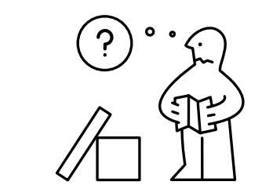
Are we understood?
Language barriers
Modal Verbs
Vocabulary != Authority
Notes:
Being the one in native English speaker in the team, my colleagues often ask if something sounds right in English. Often what makes sense in one language doesn't translate well to another. For example:
Far upp I dagen.
Another issue we found was that we were writing documentation that showcased an extensive vocabulary or consisted of run on sentences.
Model verbs: SHOULD; SHOULD NOT; MUST, MAY
Again, the dumpster fire emoji cult is just waiting to dismiss us over misunderstanding.

Slide 10
How and where do we collaborate?
Silence is a terrible form of consensus.
Notes:
As a team we took the decision early on to define what kind of documentation belonged in tools like confluence and what kind of documentation belonged in tools like Git. Since teams tended to use the tools they knew, it was extremely important that they could find the resources we provide them and that the resources stay fresh. We wanted collaboration to be open, so issues and changes were well documented. Participation was open.
Semantic versioning so people can keep track of changes.
Try to avoid managers trying to label project milestones with semver.

Slide 11
Framework
Notes:
Framework gives a paved path for engineers to ensure observability data generated in their systems can be transmitted and consumed anywhere.
It is the role of the framework to provide a straightforward means to accomplish this and to ensure the data produced by the systems is consistent and correlatable.
Structure you build software on
Data model = data entities, their attributes and relationships

Slide 12

OpenTelemetry
Data Model
Specifications
Components
Notes:
Much of the work to create an observability framework is already done for you when you adopt OpenTelemetry. The OpenTelemetry specification and the data model are well documented. For us, OTel gives us the chance to be constructively lazy. To build on an exisiting specification with the freedom to choose the tooling that is appropriate for our purposes.
Efforts done by the Otel contributors and maintains is tremendous. The specification and data model documentation is very rich and we should be very appreciative of all the work that went into creating them.
I cant imagine a framework without Otel

Slide 13
What is the minimum viable set of attributes for an atomic unit of observability?
IKEA Specific Attributes
Notes:
We at IKEA needed motivate teams to include attributes to their telemetry that provide value to the business. These attributes ensure we can ensure data ownership as well as allow observability data to be consumed between teams. We sell furniture. It is easy to lose perspective and instrument for a specific application, ignoring the consumers and the business the application is for.
The challenge isn’t in adding the attributes to the telemetry data, it is insuring the tools are compatible. Attribute names get used.
Camel case vs snake case

Slide 14
Data Model
Ensuring enterprise wide consistency in observability signals.
Notes:
The Ingka Observability Model inherits the OpenTelemetry data model for the three observability signals: traces, metrics, and logs. The OpenTelemetry data model consists of a protocol specification and semantic conventions. They are defined to unambiguously map data from various sources and scopes. To enhance the data model, and support Ingka specific requirements, the Ingka Observability Model enriches the OpenTelemetry data model by adding several attributes. The attributes are added to ensure enterprise-wide consistency in observability signals. The added attributes are based on and address the following requirements:
Observability data SHOULD be possible to use unambiguously in the Ingka organization
Observability data SHOULD be possible to correlate between dependent services
Observability data MUST allow ownership of the data to be determined
Observability data SHOULD be easy to use with machine learning and automation

Slide 15
Standards
CNCF is not a standards institution
Notes:
CNCF is not a standards institution
The Ingka Observability Standard is an extension of common industry specifications.
The Ingka Observability Standard is defined in the ADR, Architecture Decision Records, and are the foundation for the Ingka Observability Framework. The Ingka Observability Standard inherits the specifications of the CNCF OpenTelemetry project.
Systems SHOULD use OpenTelemetry as the basis for instrumentation and transmission of observability signals.
Systems MAY emit signals in formats which are supported by the OpenTelemetry collector or collector-contrib under the pretense that support for those formats relies entirely upon the OpenTelemetry community. These systems SHOULD use the OpenTelemetry protocol (OTLP) to forward this data on for consumption. These systems SHOULD NOT use the OpenTelemetry collector to translate from one non-OTLP protocol to another non-OTLP protocol.
Systems MAY emit traces, metrics or logs in other formats which are not OpenTelemetry which are consumed by systems directly under the condition that the data model described in ADR 02 is strictly followed and the data stored in the consumer can be correlated using the OpenTelemetry data model.

Slide 16
Components
OpenTelemetry Components
IKEA Specific Components
Notes:
Integration to tools like backstage
Instrumentation libraries
Collector, contrib, helm charts, Operator
Ikea Specific
Colletor configurations, processor, integrations with tools like backstage

Slide 17
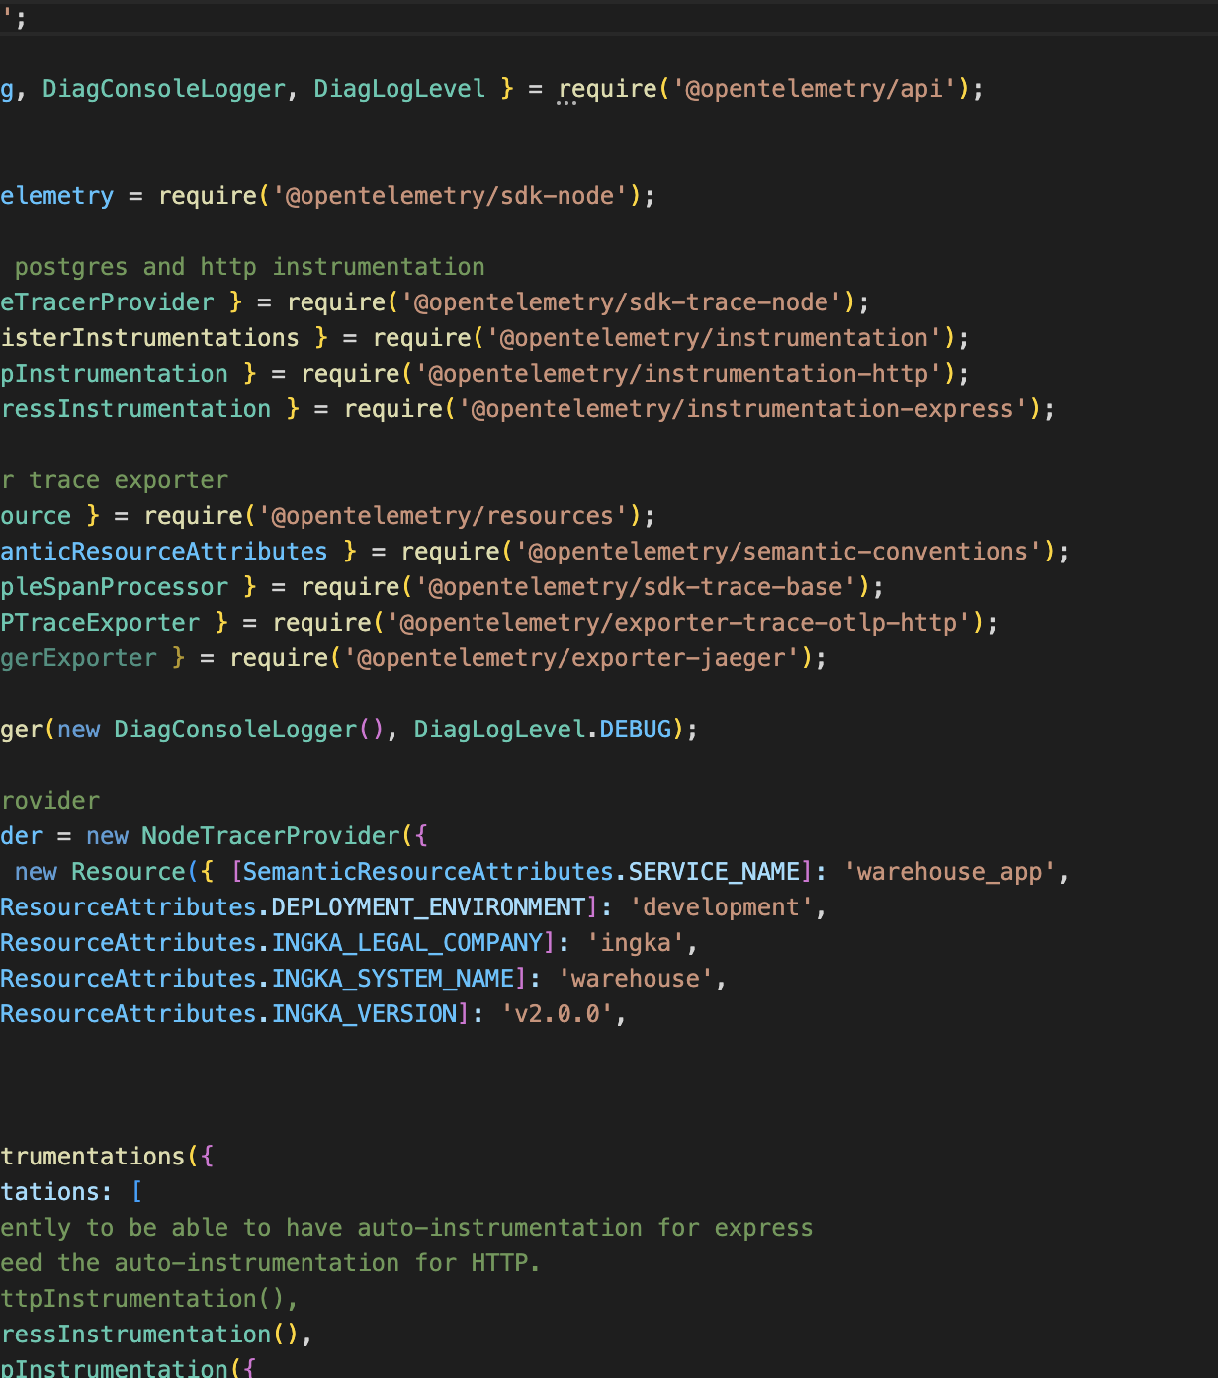
Examples
Notes:
Technical Examples
Example Teams
Teams get best-practice examples with framework attributes already in place. There is little extra effort or cognitive load.

Slide 18
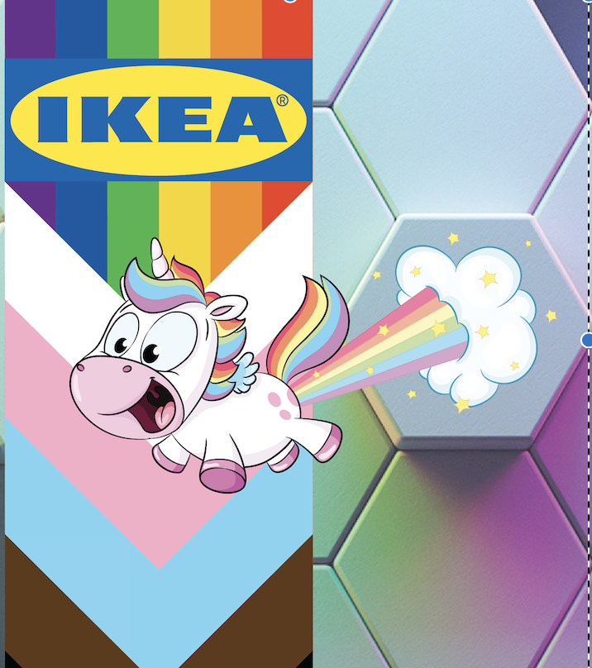
Demos and Labs
Notes:
How do we convince teams spend time and effort on implementing the framework when the value isn't inherently obvious when seen from a single service?
How do we teach them not to be bashful with their observability data?
Exposing teams to the Framework as early as possible, build it into their WoW.
Excellent means of exchanging ideas and challenges.
We are reasonable people.

Slide 19
Conclusions
Make the framework something teams want to adopt.
Ensure your consumers are invested in collaboration.
Don't present your case in a way that can be easily dismissed in an emoji
Be constructively lazy

